Slide 1
NSW School Analysis
School Location
Enrollment
Level of Schooling
ICSEA Value
Prepared by
Parvathi Maheswari Thangaraj

Slide 2
What can we find in this data ?
KPI’s used for this NSW School Analysis Dashboard to provide insights on their performance to enable data driven decisions.
Enrolment
Number of Schools
Location of School
Operation Directorate
Level of Schooling
ICSEA Value
But not limited to

Slide 3
Is Data Prep required ?
Load the Master data as CSV source for Power BI
Conversion of Data Type
Date column creation
Measure Table
Changed Column names

Slide 4
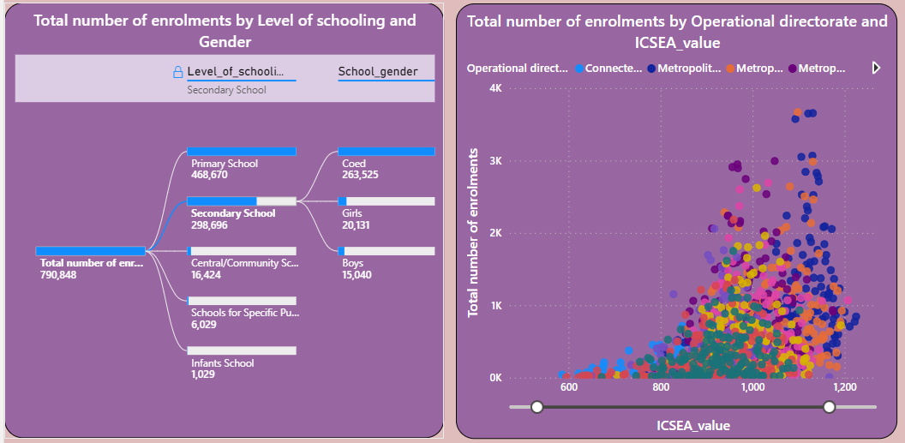
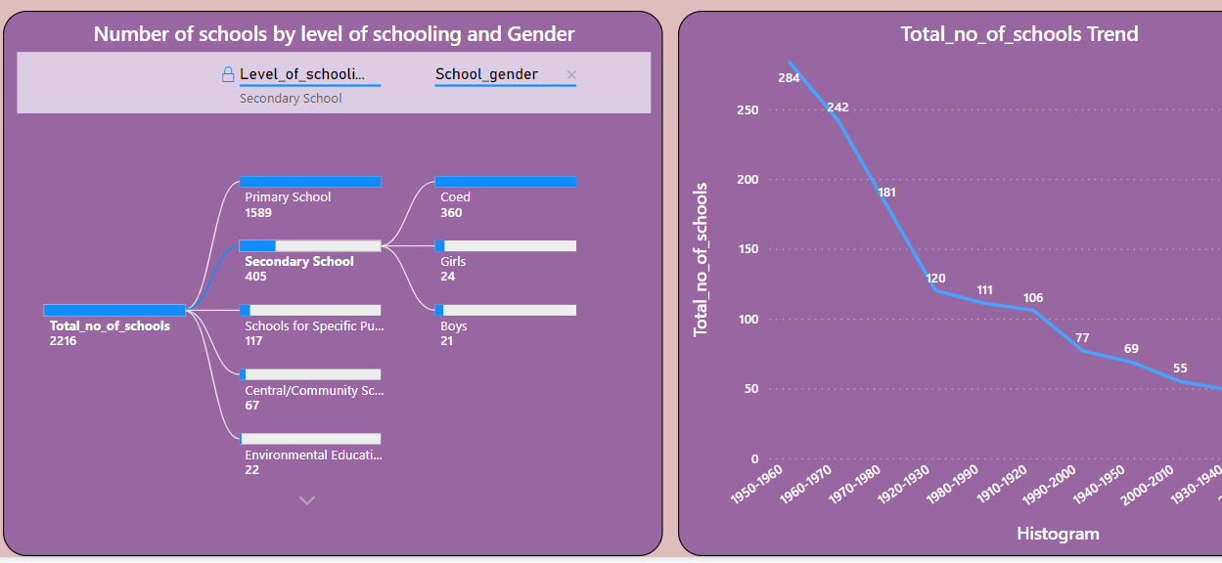
Student Enrolment
YOY enrolment% is reduced recent years.
Trend in number of schools graph has a major decline which is an area for improvement
Enrolment in Secondary education from Primary has seen a decline to almost 50% whereas no of secondary school to primary school ratio is roughly 4 times higher
Major increase in enrolment in 2018 and 2019 rest other years has been a slight decline on Y0Y
ICSEA value across NSW has been more than 500 and can be averaged between 850-1050

Slide 5
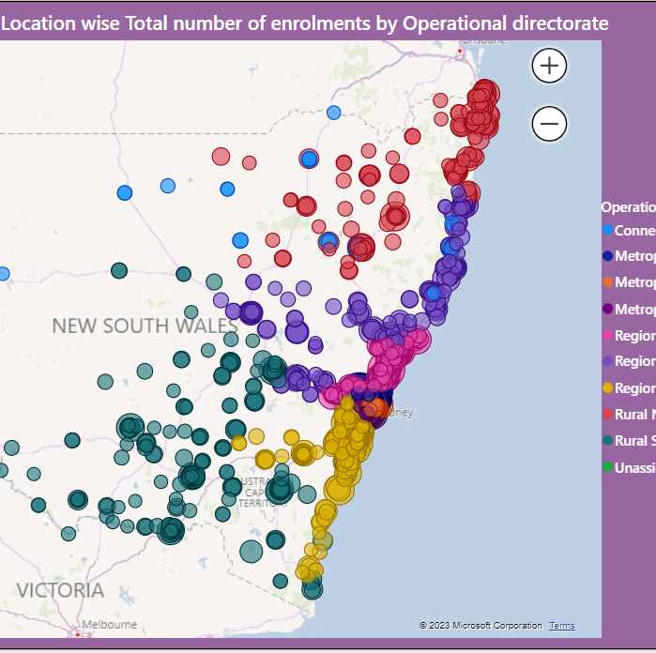
Location Info
A geo spatial representation of schools across NSW and student enrolment with their respective operational directorate

Slide 6
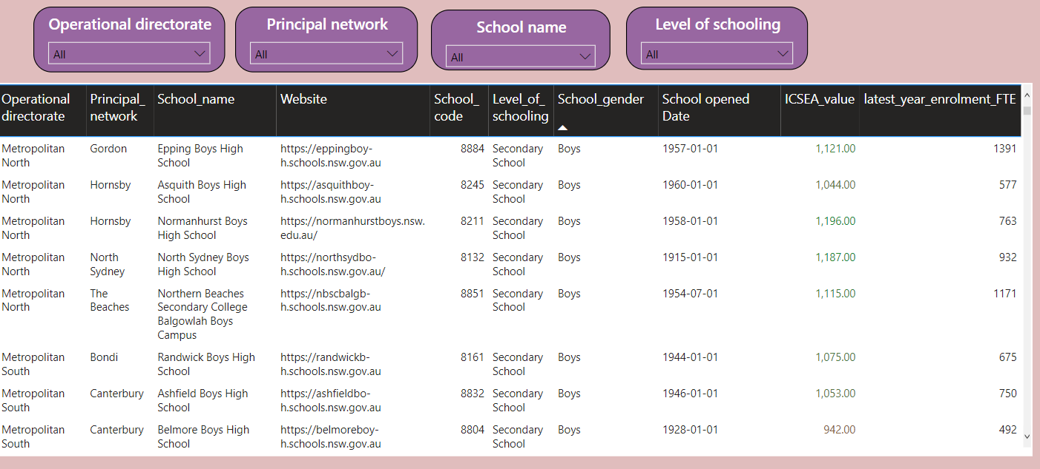
School KPI
A detailed tabular overview of school and its related ICSEA score. It also could be drilled through for a detailed matrix visualization

Slide 7
Conclusion
NSW school enrolment has been predominantly higher on the metropolitan areas and rural north areas
Rural South and West region schools are spread across South and West but the coverage of school could be improved
North West and Central part of NSW has very limited to No provision of schools.
Secondary School enrolment needs to be promoted and provision needs to accessible for extended communities

